Slide 1
Decision Tree

Slide 2
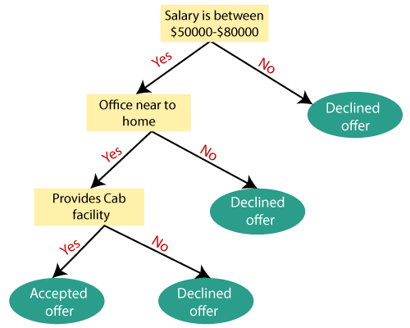
Decision Tree Terminologies
In a decision tree, for predicting the class of the given dataset, the algorithm starts from the root node of the tree. This algorithm compares the values of root attribute with the record (real dataset) attribute and, based on the comparison, follows the branch and jumps to the next node.
For the next node, the algorithm again compares the attribute value with the other sub-nodes and move further. It continues the process until it reaches the leaf node of the tree.
Step-1: Begin the tree with the root node, says S, which contains the complete
dataset.
Step-2: Find the best attribute in the dataset using Attribute Selection Measure
(ASM).
Step-3: Divide the S into subsets that contains possible values for the best m
attributes.
Step-4: Generate the decision tree node, which contains the best attribute.
Step-5: Recursively make new decision trees using the subsets of the dataset
created in step-3. Continue this process until a stage is reached where you
cannot further classify the nodes and called the final node as a leaf node.

Slide 3

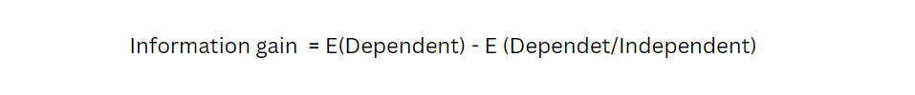
Attribute Selection Measures
1. Information Gain:
Information gain is the measurement of changes in entropy after the segmentation of a dataset based on an attribute.
It calculates how much information a feature provides us about a class.
According to the value of information gain, we split the node and build the decision tree.
A decision tree algorithm always tries to maximize the value of information gain, and a node/attribute having the highest information gain is split first. It can be calculated using the below formula:
Entropy is also a measure of randomness or impurity. It is helpful while splitting the nodes further and making the right decision. The formula for entropy is:
But with entropy, we will also be using Information gain. So, Information gain helps to understand how much information we get from each feature.

Slide 4
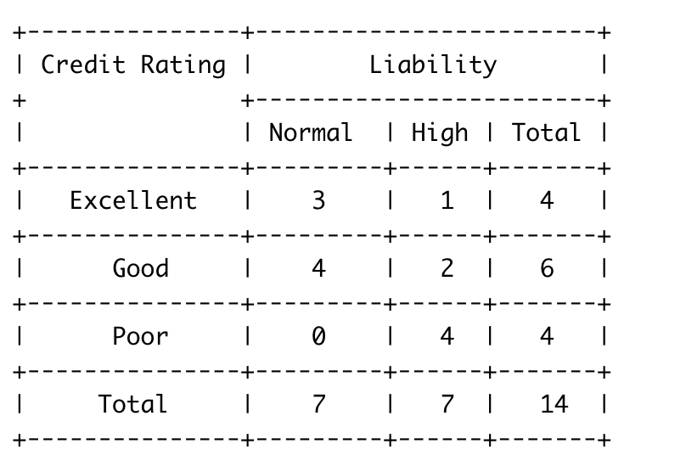
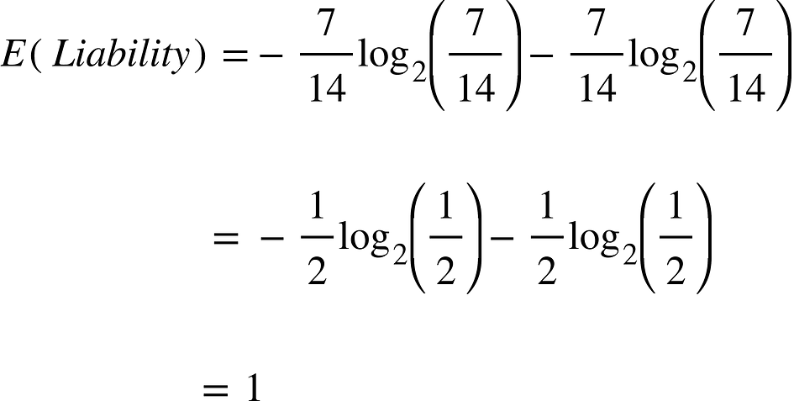
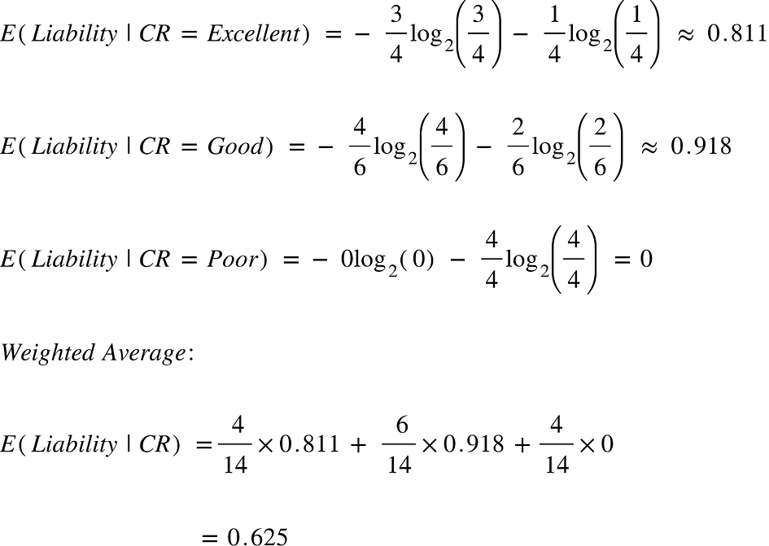
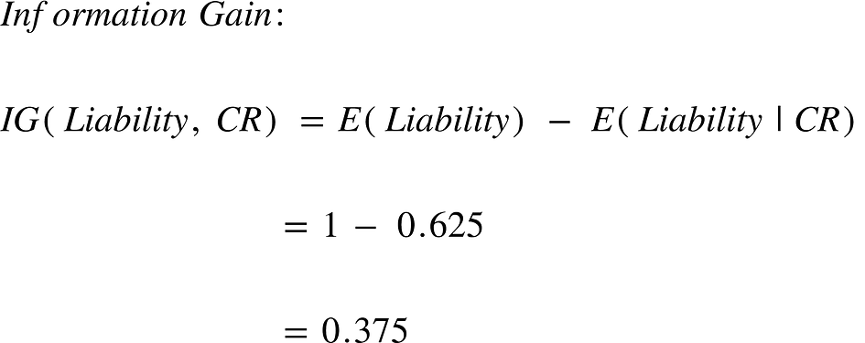
Information Gain
Here our target variable is Liability which can take on two values “Normal” and “High” and we only have one feature called Credit Rating which can take on values “Excellent”, “Good” and “Poor”. There are a total of 14 observations. 7 of them belong to the Normal Liability class and 7 belong to High Liability Class.
First entropy of our target variable by itself and then calculate the entropy of our target variable given additional information about the feature, credit rating. This will allow me to calculate how much additional information does “Credit Rating” provide for my target variable “Liability”.
Data
Target Variable
Independent Variable

Slide 5
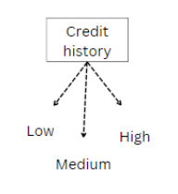
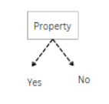
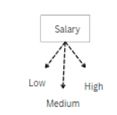
E(Credit History) = 0.625
IG(Credit History) = 0.375
E(Credit History) = 0.89
IG(Credit History) = 0.048
E(Credit History) = 0.911
IG(Credit History) = 0.029
The above image shows that credit history is the best attribute as a root node because the Information gain is more.
Similarly, we continue the process of selecting the branch node, and we can build a complete decision tree.

Slide 6

Attribute Selection Measures
1. Gini Index:
Gini index is a measure of impurity or purity used while creating a decision tree in the CART(Classification and Regression Tree) algorithm.
An attribute with the low Gini index should be preferred as compared to the high Gini index.
It only creates binary splits, and the CART algorithm uses the Gini index to create binary splits.
Gini index can be calculated using the below formula:
Where j represents the no. of classes in the target variable — Pass and Fail in our example
P(i) represents the ratio of Pass/Total no. of observations in node.

Slide 7
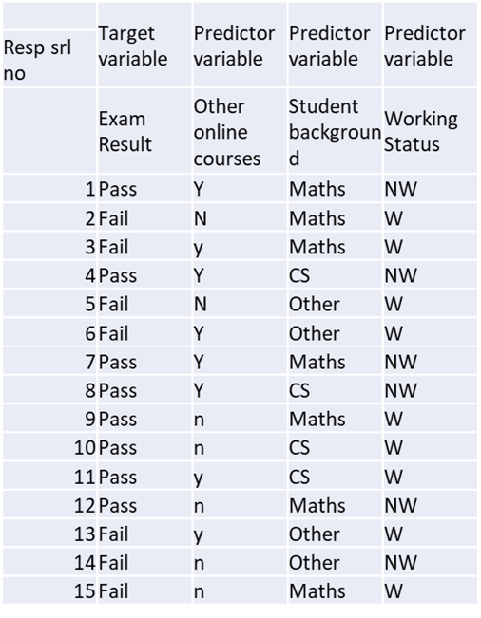
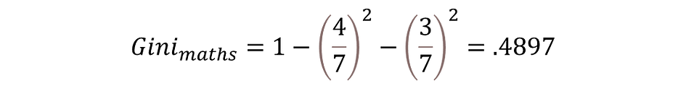
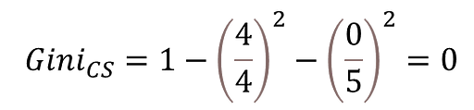
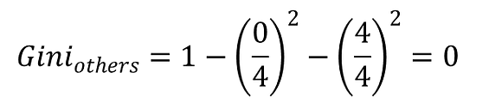

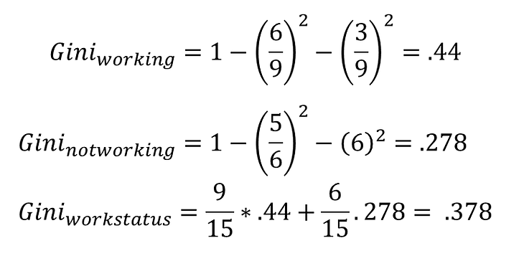
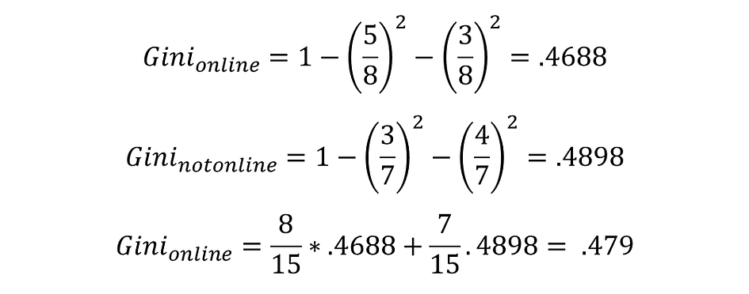
Gini Index Calculation
Maths sub node: 4Pass, 3Fail
CS sub node: 4Pass, 0 Fail
Others sub node: 0Pass, 4 Fail
Overall Gini for Background
Similarly, we can also compute the Gini Index for Working Status and Online Courses. These are given below:
Working/Not working
Online Courses

Slide 8
Hyper Parameters
The few other hyperparameters that would restrict the structure of the decision tree are:
min_impurity_decrease – It can be used to control the tree based on impurity values. It sets a threshold on gini.
max_depth – Controls the depth of the tree
min_samples_split – Minimum number of samples a node must possess before splitting.
min_samples_leaf – Minimum number of samples a leaf node must possess.
min_weight_fraction_leaf – Minimum fraction of the sum total of weights required to be at a leaf node.
max_leaf_nodes – Maximum number of leaf nodes a decision tree can have.
max_features – Maximum number of features that are taken into the account for splitting each node.
Hyperparameters explanation
https://scikit-learn.org/stable/modules/generated/sklearn.tree.DecisionTreeClassifier.html

Slide 9
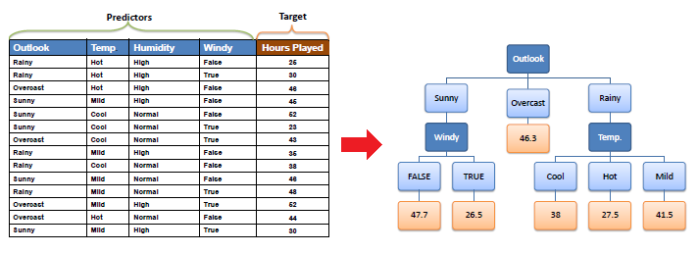
Decision Tree - Regression

Slide 10
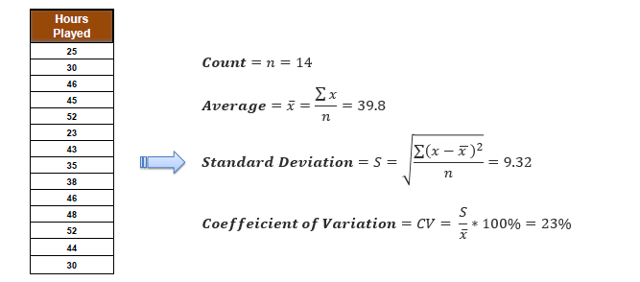
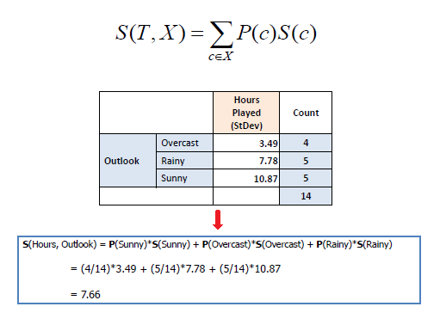
Standard Deviation:
A decision tree is built top-down from a root node and involves partitioning the data into subsets that contain instances with similar values (homogenous). We use standard deviation to calculate the homogeneity of a numerical sample. If the numerical sample is completely homogeneous its standard deviation is zero
a) Standard deviation for one attribute:
b) Standard deviation for two attributes (target and predictor):
Standard Deviation (S) is for tree building (branching).
Coefficient of Deviation (CV) is used to decide when to stop branching. We can use Count (n) as well.
Average (Avg) is the value in the leaf nodes.

Slide 11
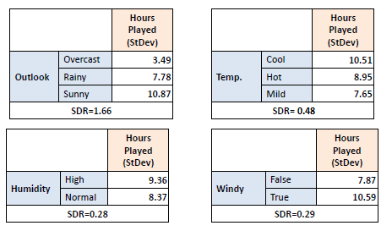
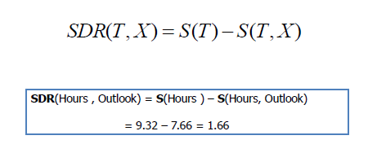
Standard Deviation Reduction
The standard deviation reduction is based on the decrease in standard deviation after a dataset is split on an attribute. Constructing a decision tree is all about finding attribute that returns the highest standard deviation reduction (i.e., the most homogeneous branches).
Step 1: The standard deviation of the target is calculated.
Standard deviation (Hours Played) = 9.32
Step 2: The dataset is then split on the different attributes. The standard deviation for each branch is calculated. The resulting standard deviation is subtracted from the standard deviation before the split. The result is the standard deviation reduction.

Slide 12
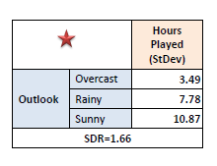
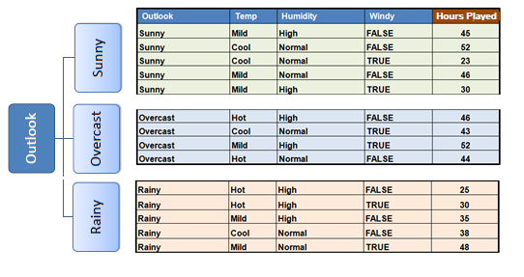
Step 3: The attribute with the largest standard deviation reduction is chosen for the decision node.
Step 4a: The dataset is divided based on the values of the selected attribute. This process is run recursively on the non-leaf branches, until all data is processed.
In practice, we need some termination criteria. For example, when coefficient of deviation (CV) for a branch becomes smaller than a certain threshold (e.g., 10%) and/or when too few instances (n) remain in the branch (e.g., 3).

Slide 13
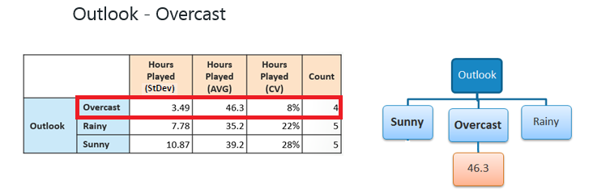
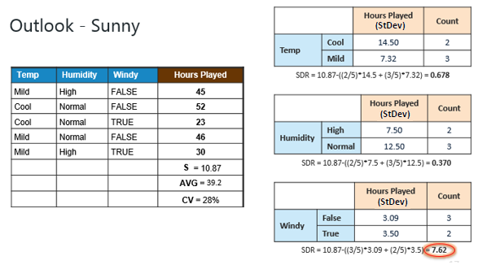
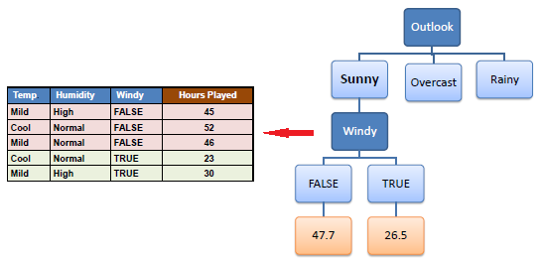
Step 4b: "Overcast" subset does not need any further splitting because its CV (8%) is less than the threshold (10%). The related leaf node gets the average of the "Overcast" subset.
Step 4c: However, the "Sunny" branch has an CV (28%) more than the threshold (10%) which needs further splitting. We select "Temp" as the best best node after "Outlook" because it has the largest SDR.
Note: Because the number of data points for both branches (FALSE and TRUE) is equal or less than 3 we stop further branching and assign the average of each branch to the related leaf node.

Slide 14
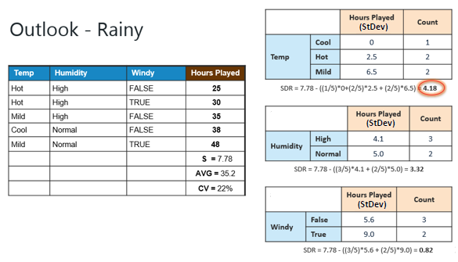
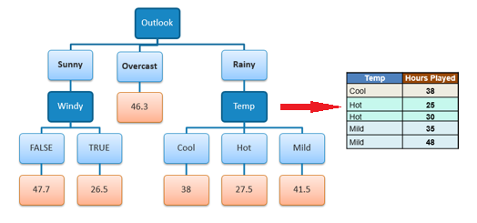
Step 4d: Moreover, the "rainy" branch has an CV (22%) which is more than the threshold (10%). This branch needs further splitting. We select "Temp" as the best best node because it has the largest SDR.
Because the number of data points for all three branches (Cool, Hot and Mild) is equal or less than 3 we stop further branching and assign the average of each branch to the related leaf node.
When the number of instances is more than one at a leaf node we calculate the average as the final value for the target.

